Slide 2
Where to put the service?
Discussing different architectures of a source code.
Vladimir Zatsepin
Java Software Developer

Slide 3

Problem
Sometime at the beginning of a new project…
Alice: “Where to put the service?”
Bob: “To the right package.”
Alice: “Which one?”
Bob:

Slide 4

Source of truth

Slide 5
Agenda
Architecture
Example app
Layered architecture
Clean architecture
Hexagonal architecture
Enforcing architecture boundaries
Taking shortcuts
Yet another architecture

Slide 6

Architecture
Your architecture should provide the right answer.
Architecture defines rules that you use to decide how to decouple and couple components.
With good architecture, we are keeping our options open and are able to quickly adapt to changing requirements and external factors.
Architecture, when properly enforced*, plays role of a back pressure preventing you from creating mass in the face of the looming deadline.

Slide 7
Example App – Solutions Hub
Use cases
Create solution
  Name, description, readme content, tags
Search other solutions
Implementation
Java
Spring Boot as main framework
MongoDB as main database
ElasticSearch as search database

Slide 8
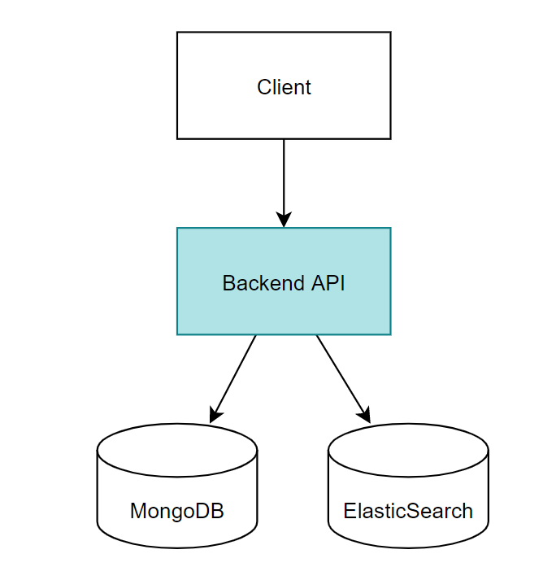
Example App – Solutions Hub

Slide 9
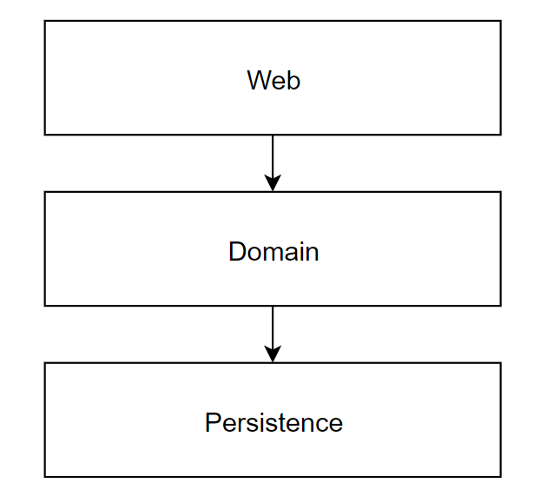
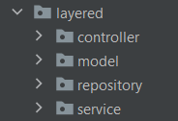
Conventional layered architecture

Slide 10
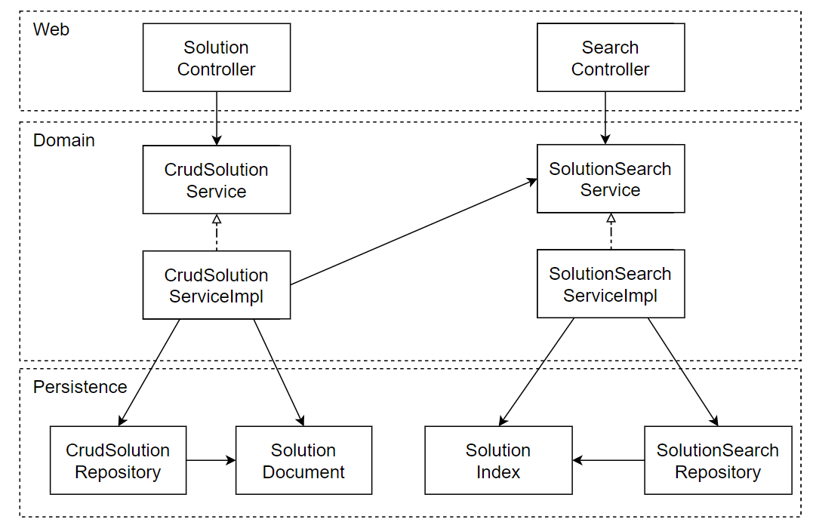
Layer architecture

Slide 11
Layer architecture – What’s wrong?
It promotes Database-Driven Design
It’s prone to short cuts
It hides the use cases

Slide 12
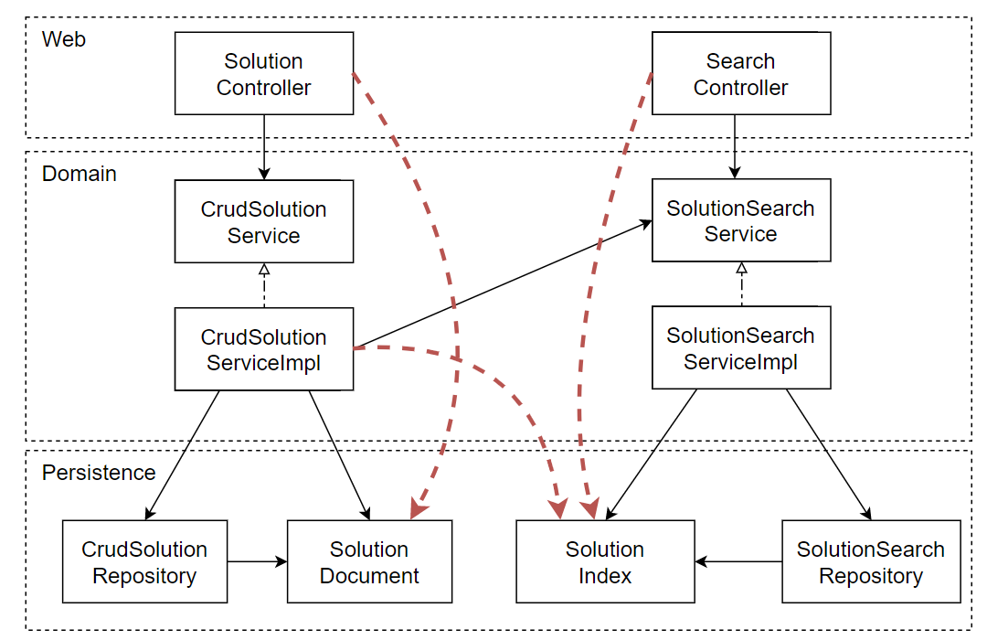
It promotes Database-Driven Design

Slide 13
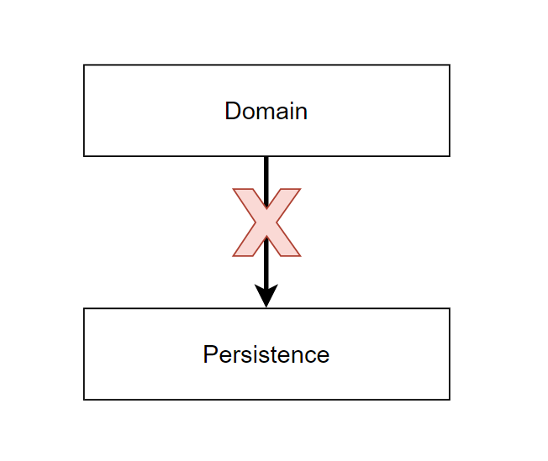
It promotes Database-Driven Design
Model behavior, and not state.
The behavior is what changes the state and thus drives the business.

Slide 14
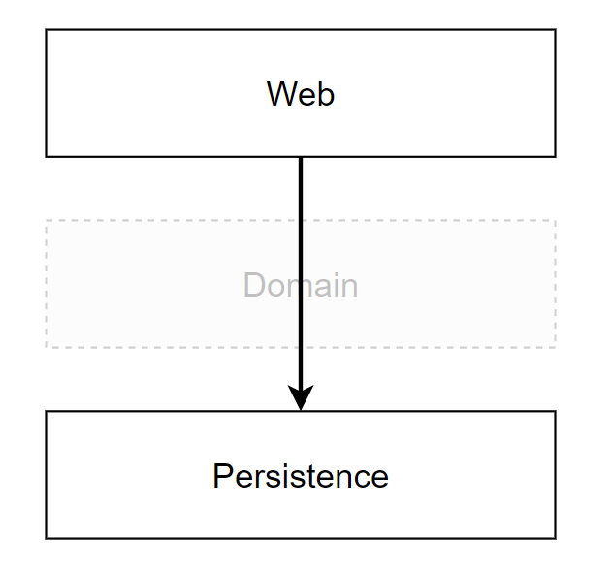
It’s prone to short cuts

Slide 15
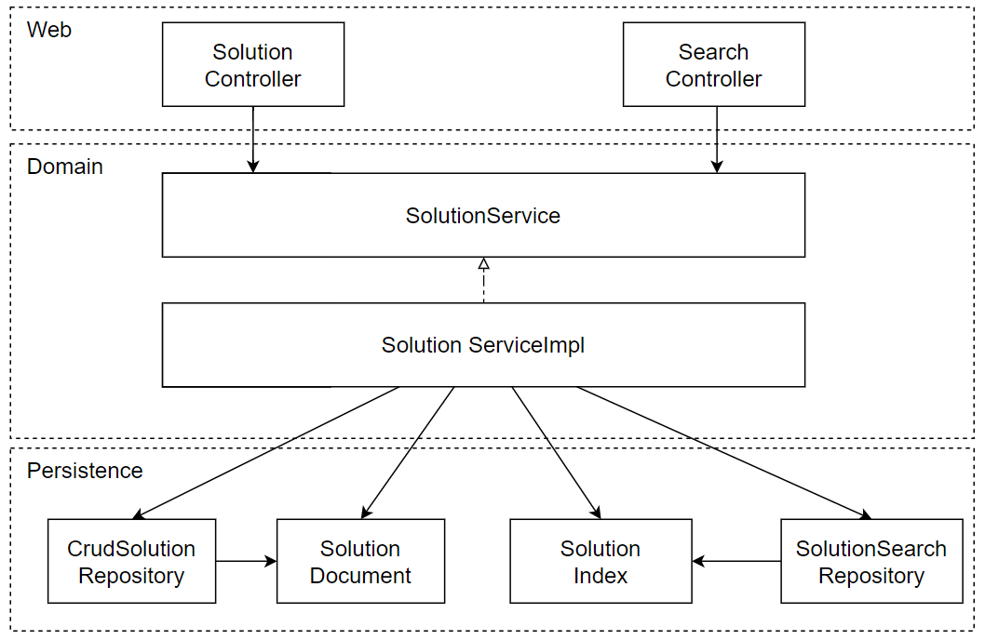
It hides the use cases: 1

Slide 16
It hides the use cases: 2
Screaming Architecture
“When you look at the top level directory structure, and the source files in the highest level package; do they scream: Health Care System, or Accounting System, or Inventory Management System? Or do they scream: Rails, or Spring/Hibernate, or ASP?”

Slide 17
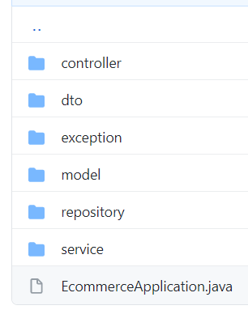
It hides the use cases: 2

Slide 18
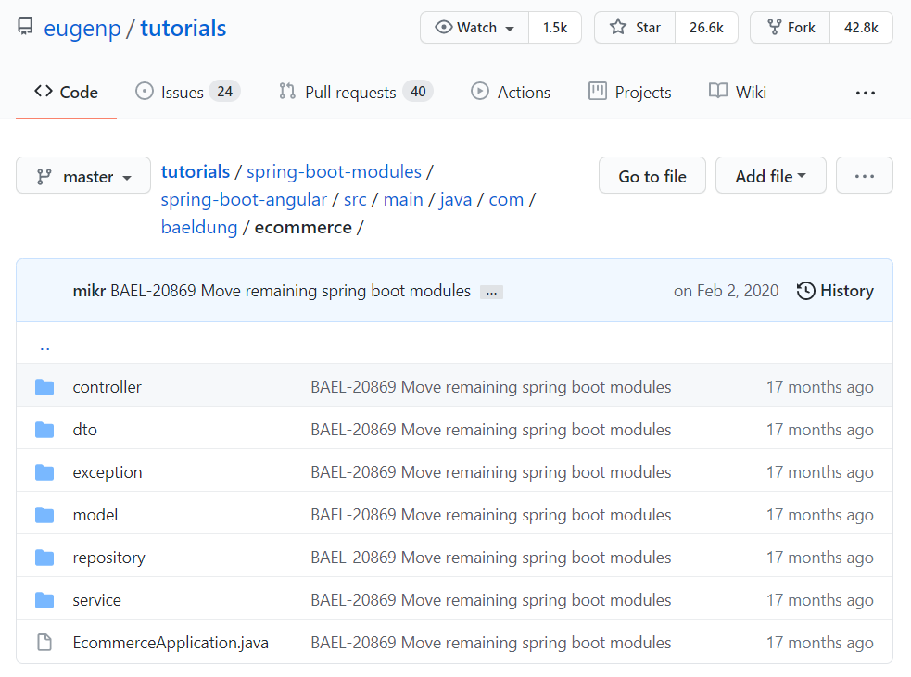

It hides the use cases: 2
26.6K Stars

Slide 19
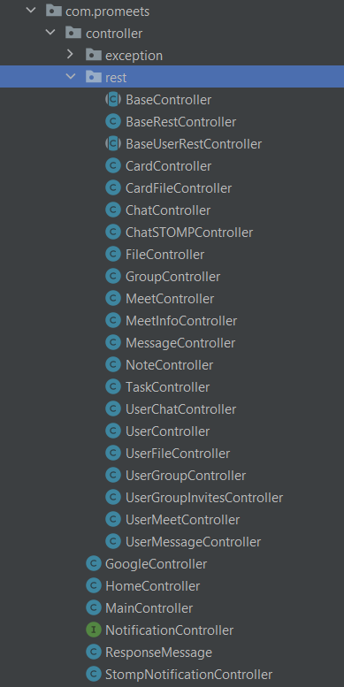
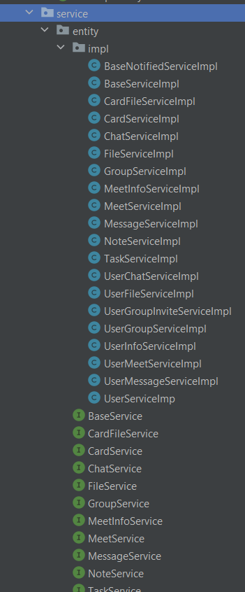
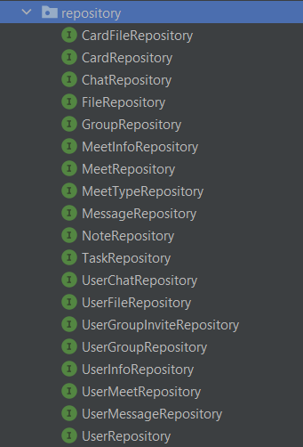
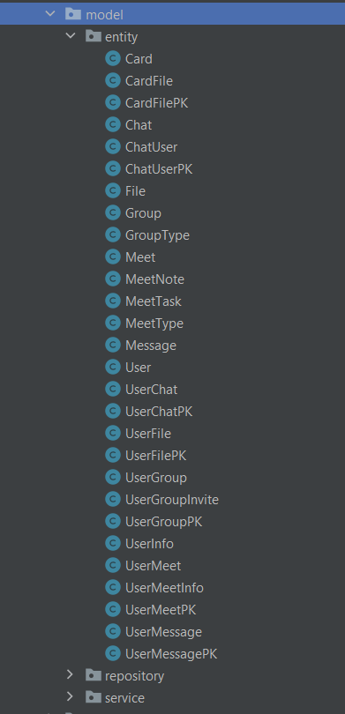
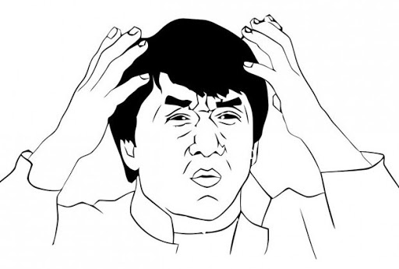
It hides the use cases: 2
Controllers
Services
Repositories
Models

Slide 20
Single responsibility

Slide 21
Dependency inversion

Slide 22
Clean architecture

Slide 23
Hexagonal architecture

Slide 24
Enforcing architecture boundaries
ArchUnit

Slide 25
Taking shortcuts

Slide 26
Yet another architecture

Slide 27
Q&A

Slide 28
Where to put the service?
Vladimir Zatsepin
Java Software Developer

